Slide 1
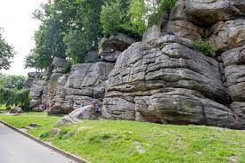
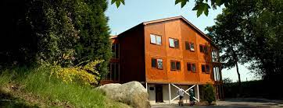
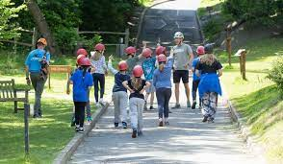
Bowles

Slide 2
The purpose of the meeting is primarily to:
Complete medical forms needed by the school and Bowles.
To explain the activities the children will be participating in.
Explain grouping and accommodation.

Slide 3
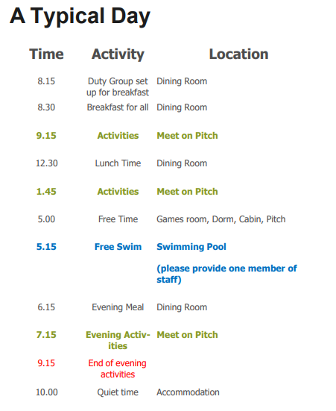

Slide 4
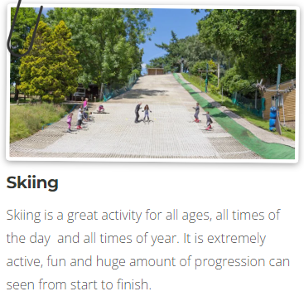
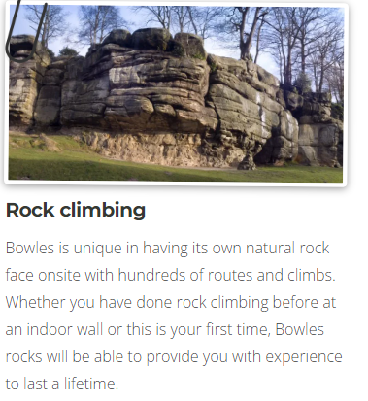
The following are examples of some of the activities we participate in:

Slide 5
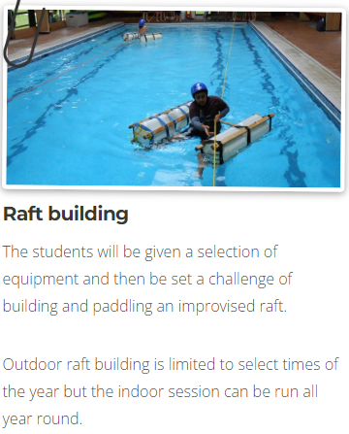


Slide 6
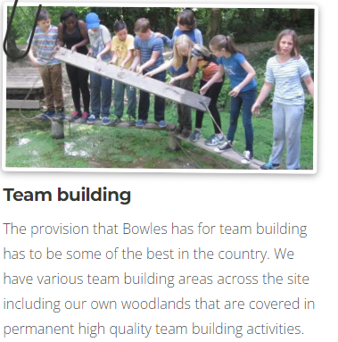
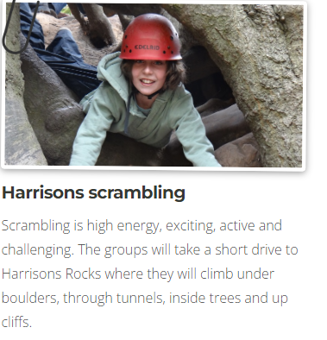

Slide 7
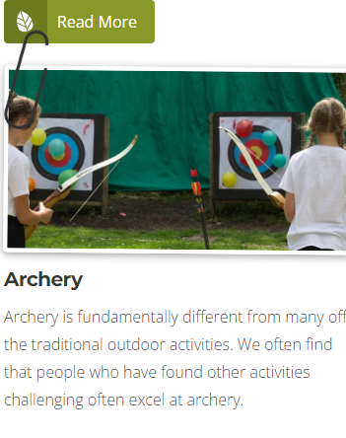
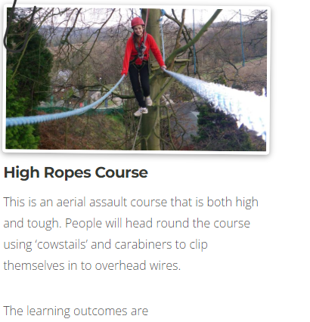
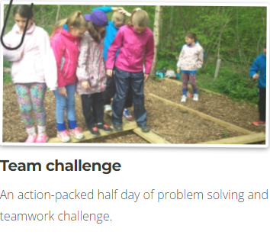

Slide 8
The children are in groups of approximately 12. There will be a member of Bowles staff and a member of Old Bexley staff with each group.
The rooms are dormitory style and sleep up to 7.
They will be with at least one of their closest friends.

Slide 9
https://bowles.rocks/schools-and-colleges/residential/life-at-bowles/

Slide 10
Please ensure that full payment has been made for the trip by 11th July 2025.
If you are having difficulty with payments please contact Mrs Ivil via the office email.
Unfortunately if full payment has not been made your child will not be able to participate in the trip.

Slide 11
Hoodies (optional) are available to be ordered until 23 July via your MyChildAtSchool account.
Late orders will not be accepted.
Once ordered the size cannot be altered.
Sizes available:
Age
9-11 £16.80
12-13 £16.80
Adult extra small £16.80
Adult small £18.50
Adult medium £18.50
Please do not add your child's name onto the back of the hoodie, their initials on the front would be acceptable.

Slide 12


